Slide 1
Smart IntraVenous Drip Infusion Monitoring System Using Loadcell & IoT
A Mini project ppt
PRESENTED BY : NISHANTH.A 810019105052 RANJITH.P 810019105065 SAKTHIVEL GP 810019105070 SYED MASOOD.P 810019105086 TAMILARASU.T 810019105088 Crew Chief : Dr R.KANIMOZHI

Slide 2
INTRODUCTION
Adequate hydration via a saline drip is essential during surgery, but recent reports suggest that getting the balance of salt and water just right could have an important impact on patient recovery.
Saline delivered intravenously during and after surgery helps to maintain a patient’s fluid balance and blood pressure within the appropriate range.
The increased salt concentration in the hypertonic saline is designed to keep the body in equilibrium by helping to reduce fluid buildup in the lungs, interstitial spaces and swelling in the extremities. The hypertonic saline draws out the excess fluid that builds up in these tissues.
The current study is the largest of its kind and shows a benefit when hypertonic saline is used for the Whipple operation, which can take from to 5-9 hours to perform.

Slide 3
PROBLEM IDENTIFICATION
During infusion it is difficult for a nurse to monitor or keep count on the level of saline bottle
This occurrence affects approximately 6.5% of patients in hospitals worldwide
If not monitored, it causes severe illness in patients such as embolism and vein inflammation
In a hospital, the significant problem faced by the nurse or attendant is to ensure the level of saline bottle periodically. Reverse flow of blood would occur when the nurse forgets to change the saline bottle which leads to the patient life at risk

Slide 4
OBJECTIVE
We are proposing a system in which remote drip infusion monitoring and alert system will be developed for hospitals.
Life saving system
This project proposes a novel proof-of-concept system that uses non-invasive sensing in conjunction with a low-power embedded computing platform to deliver continuous infusion monitoring around the IV catheter site.
This need of invention will help the next era of nursing and care takers to monitor the IV fluid feeding system in a fully automated mode.
Moreover, the low-power design and wireless capabilities can potentially enable continuous wear.

Slide 5
BLOCK DIAGRAM
.
POWER SUPPLY
LOAD
CELL
S
A
L
I
N
E
IoT Module
(ESP 8266)
BUZZER
AMPLIFIER

Slide 6
EXISTING SYSTEM
If an air bubble enters the bloodstream of the patient it may cause an air embolism, therefore, it is crucial that all air bubbles are detected and removed during the surgery. The current process relies on a nurse to constantly monitor the intravenous(IV) line for bubbles and pinch the line manually if a bubble is detected.
They must also ensure that the pressure of the saline bag is maintained within a certain range and the saline bag does not become empty.
The device discussed in this project was designed to implement these tasks automatically so the nurse’s work level stress would decrease, and their focus and energy could be directed to the patient’s well-being.

Slide 7
PROPOSED SYSTEM
This study aims to develop an automatic system of tools infusion that can monitor the condition of the infusion volume and monitor the condition of droplets performed remotely using IoT technology.
This project relates with the saline level of a patient through remote technology in health care centers to monitor patient’s data constantly. The design has been made simple with two main functions are remote monitoring for the condition of the contents/detection volume of infusion fluids and drips or absence of intravenous fluids.
The status intravenous fluid volume used by patients divided into three categories namely: High: intravenous fluid condition > 50%; Medium: the condition of the Saline level 50-20% and Low: < 20% level in Saline bag

Slide 8
HARDWARE DETAILS
POWER SUPPLY
LOAD CELL AND AMPLIFIER
IOT MODULE (ESP 8266-12E)
BUZZER
RECTIFIERS & REGULATORS

Slide 9
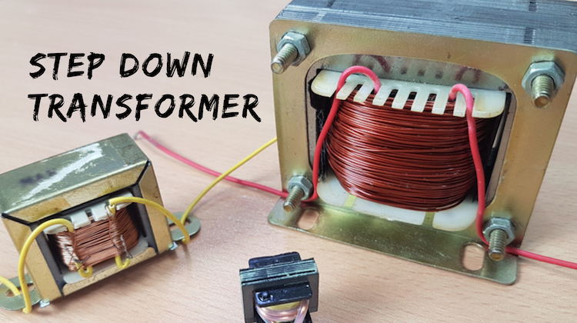
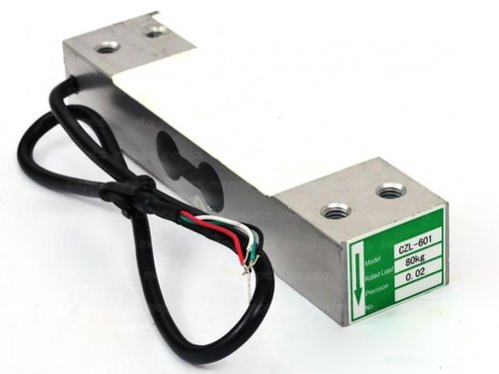
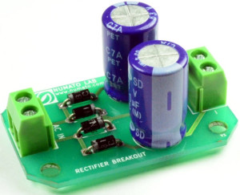
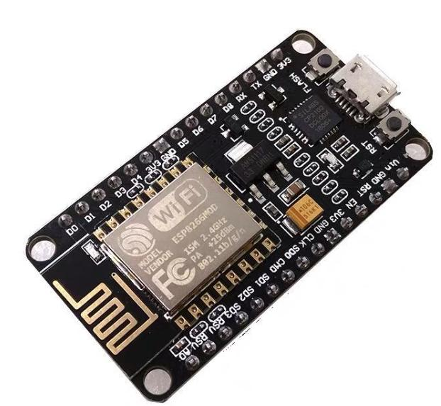
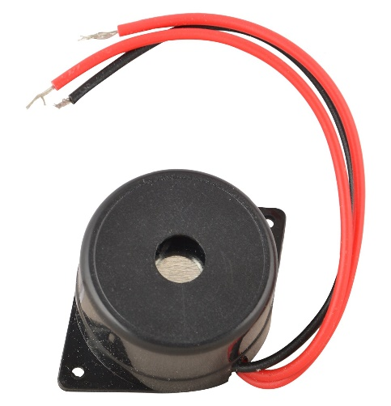

Slide 10
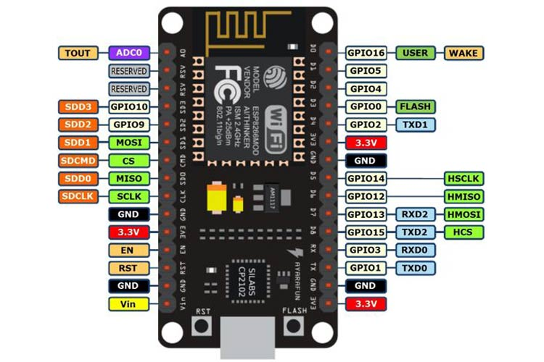
NODEMCU ESP8266
Node MCU is an open source IoT platform.
It includes firmware which runs on the ESP8266 Wi-Fi SoC from Espressif Systems
Hardware which is based on the ESP-12 module.
The term "Node MCU" by default refers to the firmware rather than the dev kits.
The firmware uses the Lua scripting language.
It is based on the eLua project, and built on the Espressif Non-OS SDK for ESP8266. It uses many open source projects, such as lua-cjson, and spiffs.

Slide 11
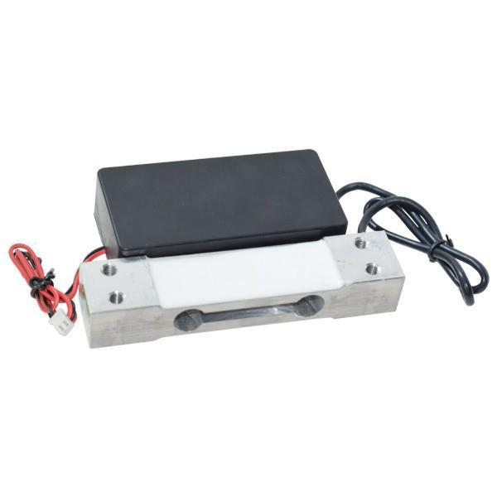
Load cell & amplifier
A load cell is a transducer that is used to create an electrical signal whose magnitude is directly proportional to the force being measured.
This electronic signal can be a voltage change, current change or frequency change depending on the type of load cell and circuitry used.
The electrical signal output is typically in the order of a few milli-volts and requires amplification by an instrumentation amplifier before it can be used
The change in resistance of the strain gauge provides an electrical value change that is calibrated to the load placed on the load cell

Slide 12
SOFTWARE DETAILS
ARDUINO IDE – ESP NODEMCU PACKAGE ADDED
EMBEDDED C- ESP PROGRAMMING LANGUAGE
CAYENNE SERVER & CAYENNE APP
PROTEUS FOR MODEL SIMULATION

Slide 13
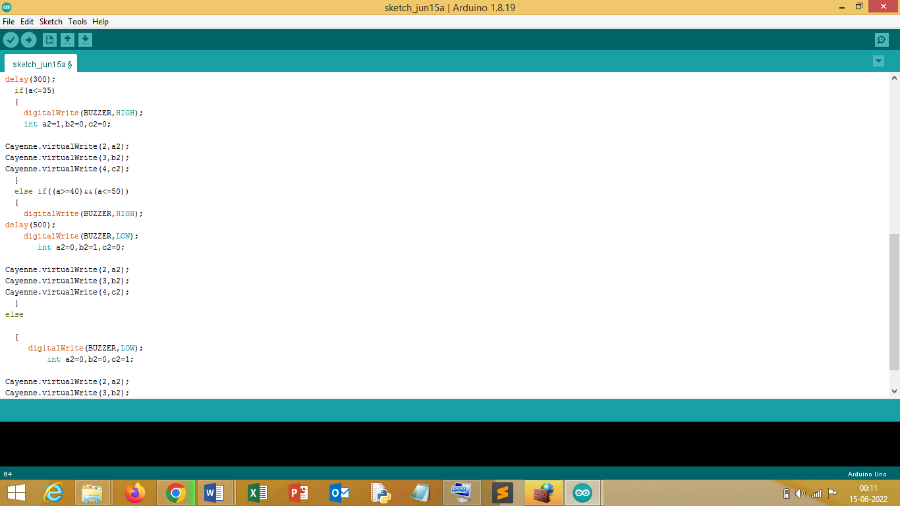
ARDUINO IDE
The open-source Arduino Software (IDE) makes it easy to write code and upload it to the board.
Arduino’s mission is to enable anyone to enhance their lives through accessible electronics and digital technologies.
There was once a barrier between the electronics, design, and programming world and the rest of the world.

Slide 14
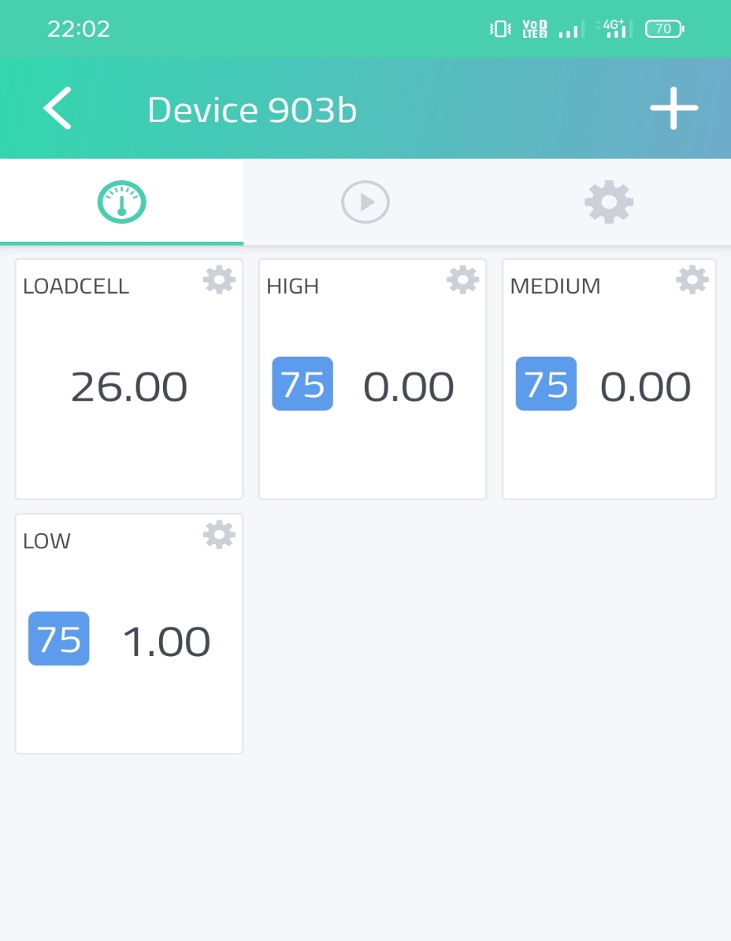
CAYENNE APP/SERVER
myDevices Cayenne allows you to quickly design, prototype, and visualize IoT solutions.
You can use Cayenne as a tool to visualize real-time and historical data, sent over The Things Network.
In order to display your content in the Cayenne dashboard, the payload has to be encoded with the Cayenne Low Power Payload (Cayenne LPP).
MQTT is an OASIS standard messaging protocol for the Internet of Things (IoT).
It is messaging transport that is ideal for connecting remote devices with a small code footprint and minimal network bandwidth.

Slide 15
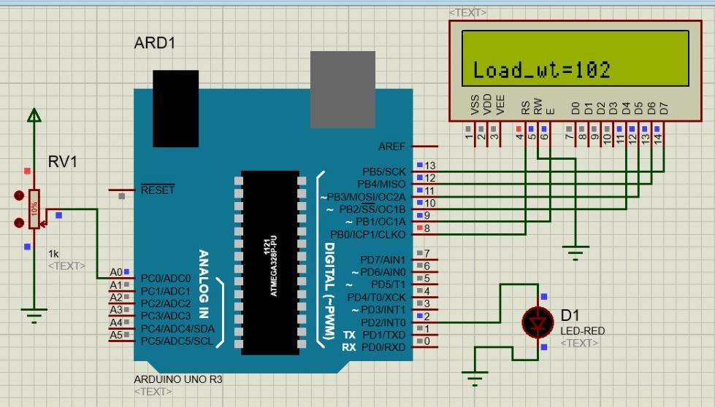
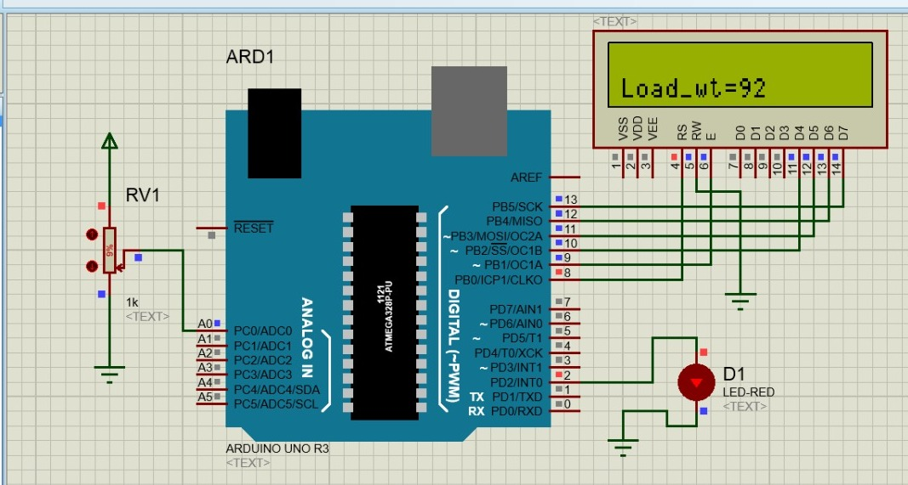
AT NORMAL CONDITION
* FOR SIMULATION PURPOSE ARDUINO BOARD IS USED
LOW LEVEL

Slide 16
AUTHOR & YEAR | SUMMARY | KEYPOINTS / HIGHLIGHTS
C.GAVIMATH,KRISHNAMURUTHY BHAT,C.L.CHAYALAKSHI,R.S.HOOLI AND B.E.RAVISHANKERA 2012 | A SIMPLE GSM BASED ALERT IN SYSTEM IN MOBILES | GSM BASED REMOTE MONITORING DEVICE
PRIYADHARSHINI,MITHUNA VASANTH AUGUST 2012 | PLACED THE ULTRASONIC SENSOR ON THE TOP OF THE IV BAG/BOTTLE | USING ULTRASONIC SENSORS
MANSI G. CHIDGOPKAR SEPTEMBER-2015 | LITTLE OUTDATED METHOD USED (LIKE USING ROUTERS FOR DATA ANALYSIS) | WIRELESS BLUETOOTH MODULE AND Cc2500 TRANSRECEIVER
KALAIVANI,SINDHU, THAMARAISELVI MARCH-2017 | USED THE IR SENSOR AND ULTRASONIC SENSOR AND TRANSFERED DATA TO THE WEB PLATFORM USING IoT | USING IR & ULTRASONIC SENSORS & IoT

Slide 17
ADVANTAGES
Avoids the risk of reverse blood flow.
Avoids the risk of over dosage
Provides easiness in the monitoring of saline infusion of long duration
Nurses can be little bit free without any tension about the saline level

Slide 18
DISADVANTAGES
Buzzer sound will disturbs the patients
Implementation will take a long time
Network issues & Reliability should be taken into consideration

Slide 19
CONCLUSION
SICoMS have to be designed with two main functions: remote monitoring for infusion fluid volume and detection of infusion fluid.
•The loadcell sensor can be used as the volume sensor of the infusion by converting the liquid mass
to the infusion volume. and loadcell mass measurement error of 4.48%
•Infrared sensors can be used as sensors to detect the presence or absence of drip drops.
MQTT-S protocol as it is efficient for low cost and low power devices. Furthermore, MQTT-S also provides guaranteed delivery of messages as it supports asynchronous communication using buffering of messages

Slide 20
FUTURE SCOPE
In the future a more compact system can be made by installing a more efficient miniature load cell to the stand on which the saline bottle hangs.
The Number of solenoid valves can be reduced by installing a multi functional solenoid valve which will make the system more compact.
Accuracy in the dosage can be increased by providing more health vital data to the system which helps in giving other costly medications through saline infusion

